Slide 1
Multiple Models in One Application Security barrier demo
Notes:
We have already seen the sample application using only one single model, but what if we need to chain multiple models together in one application? Do we need to send the same copy of the original frames to each of the models used in this application? Can we use different devices for inferencing different models? Let’s look at this security barrier demo application and find out the answers from there.

Slide 2
Video Analytics in Intel® Distribution of OpenVINO™ Toolkit
Topology | Type | Description
vehicle-license-plate-detection-barrier-0007 | detection | Multiclass (vehicle, license plates) detector based on RESNET* 10 plus SSD.
vehicle-attributes-recognition-barrier-0010 | object_attributes | Vehicle attributes recognition with modified RESNET 10 backbone.
license-plate-recognition-barrier-0001 | ocr | Chinese license plate recognition.
Notes:
In this demo application, three models will be used. The first model is an object detection model, which can detect multiple classes, the vehicle, and the license plate. The second model can recognize the attributes of a vehicle, such as type and color. The third model is an Optical Character Recognition model trained to read Chinese license plates.

Slide 3
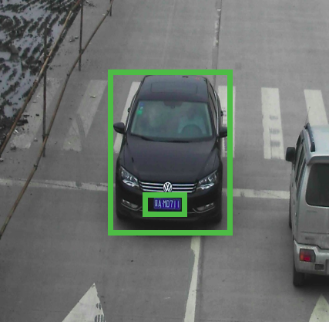
vehicle-license-plate-detection-barrier-007 Use Case/High-Level Description
RESNET* 10 plus SSD-based vehicle and (Chinese) license plate detector for "Barrier" use case.
Notes:
These three models are chained together in this demo application. When the original frame is sent to the first vehicle and license plate object detection model, the model detects there’s a vehicle in the frame and the vehicle has a license plate, so the output contains the x, y coordinates information of these two objects.
The application not only draws the bounding boxes around the vehicle and the license plate based on their x, y coordinates, it also crops the detected vehicle region and sends it to the vehicle attributes recognition model. Same for the license plate, the cropped region will be sent to the license plate recognition model.

Slide 4
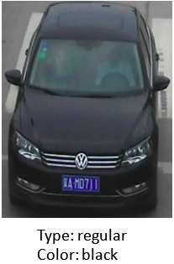
vehicle-attributes-recognition-barrier-0010 Use Case/High-Level Description
Vehicle attributes classification algorithm for a traffic analysis scenario.
Notes:
So, the vehicle attributes recognition model does not need to infer the original image frame, it takes the cropped region of the detected vehicle as input and recognizes this is a regular vehicle with black color.

Slide 5
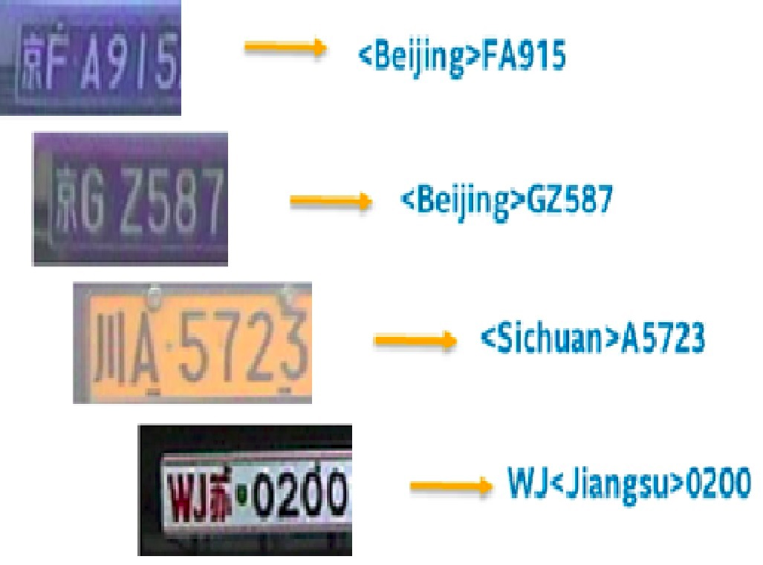
license-plate-recognition-barrier-0001 Use Case/High-Level Description
Small-footprint network trained E2E to recognize Chinese license plates in traffic scenarios.
Note: The license plates in the image are modified from the originals.
Notes:
Same for the license plate recognition model, only need to infer the cropped region of the detected license plate.

Slide 6
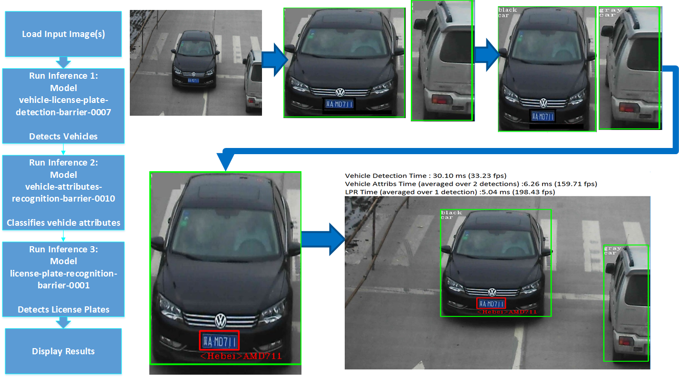
Security Barrier Demo
Notes:
Here is the workflow of how these three models cascaded in the application.
For each model used here, we will need to create an inference request for it, and you choose different device for each of them.

